Slide 1



TYPE GENIUS : SMART TYPING EVALUATOR
BASAVESHWAR ENGINEERING COLLEGE, BAGALKOT
DEPARTMENT OF COMPUTER SCIENCE AND ENGINEERING
Academic year : 2025-26
Under Guidance of :
Prof .M.G KAMBALIMATH
Presented by | USN
Amith S K | 2BA23CS012
Basavaraj Biradar | 2BA23CS023
Bharatakumar G Nadakur | 2BA23CS026
Krishna Kulkarni | 2BA23CS051

Slide 2
CONTENTS
Sl.no | Table of Contents
1 | Introduction
2 | Problem statement
3 | Proposed solutions
4 | Literature survey
5 | Objectives
6 | Implementation
7 | Modules
8 | Block Diagram
9 | Conclusion
10 | References

Slide 3
INTRODUCTION
A desktop or web-based application for typing practice displays a snippet for users to type and evaluates their input.
It provides feedback on both accuracy and typing speed (measured in words per minute), helping users identify mistakes and track their progress. By offering consistent practice, the application supports users in improving their typing skills effectively.

Slide 4
PROBLEM STATEMENT
Many students lack proficiency in typing, which reduces both speed (WPM) and accuracy, affecting their academic and professional efficiency.
Traditional teaching methods often fail to provide real-time feedback and measurable progress in typing skills.
There is a need to evaluate the effectiveness of Typing software in improving accuracy and WPM through structured practice and assessment.

Slide 5
PROPOSED SOLUTIONS
  Clean, friendly UI (Typ­ing Master still feels like a Windows 7 app).
  Real-time Error Detection (wrong key presses, missed keys).
  Virtual Keyboard Visualization for beginner
  Coding Mode ,which helps to increase coding speed.

Slide 6
LITERATURE SURVEY
TypingMaster: Professional typing tutor software.
Authors: Anna Feit and Per Ola Kristensson
Year: 2018
Main Finding:
The researchers discovered that not all users learn typing in the same way — their background (student, professional, age, etc.) strongly influences how fast they improve, how long they continue practice, and how they use typing tools.This helped highlight the need for personalized and user-specific typing training systems, rather than one-size-fits-all solutions.

Slide 7
LITERATURE SURVEY
Teaching.com : Typing.com is a Free typing tutor and digital literacy platform.
Author: Venny Karolina
Year: 2016-17
Main Finding:
The study found that students showed measurable improvement in both speed (WPM) and accuracy after using Typing.com regularly.
The platform’s gamified structure and progressive lessons helped maintain consistency in practice.

Slide 8
OBJECTIVES
To evaluate and improve user typing skills by measuring speed, accuracy, and consistency across multiple difficulty levels.
To provide adaptive typing modes that match the skill level and learning pace of different users.
To create an interactive and user-friendly interface that encourages regular practice and enhances the overall typing learning experience.
To support coding literacy by allowing users to practice typing syntactically accurate code snippets in multiple programming languages.

Slide 9
IMPLEMENTATION
Technologies Used:
Frontend: HTML, CSS.
Backend: JavaScript, PHP.
Database: Oracle MySQL.

Slide 10
MODULES
Login/Register: Secure user access.
Homepage: Overview of the site.
Mode Selection: Selection of mode based on their level.
Typing Evaluation: Paragraph display, typing input, accuracy & speed calculator.
Result Display: Shows performance metrics.

Slide 11
BLOCK DIAGRAM
LOGIN/
REGISTER
HOMEPAGE
MODE
SELECTION
EVALUATION
RESULT

Slide 12
MODES
BEGINNER
INTERMEDIATE
ADVANCED
CODING
01
02
A slow and simple typing test designed to help new learners type confidently.
A balanced typing test with moderate speed and accuracy challenges.
03
04
A fast-paced typing test for advanced users to push their typing speed limits.
A typing test using real code snippets to improve speed, accuracy, and programming fluency

Slide 13
EVALUATION RESULT
Accuracy calculation: Percentage (%) of correctly typed characters. That is
(Correctly Typed Characters/Total Characters) x 100
WPM calculation: Words typed per minute .Improves typing speed and accuracy through repeated practice
Time Taken : The total time taken to complete the Sentence/Code

Slide 14
CONCLUSION
Conclusion:
The project successfully evaluates typing skills with accuracy & WPM.
Provides different levels for practice.
Future Scope:
AI-driven Personalisation.
Gamification & Social Features.
Multiplatform & Cloud Sync.

Slide 15
REFERENCES
Fatima, S., & Puspasari, D. (2021). The Influence of Using Typing Master Application Media on 10 Finger Typing Skills in Office Technology Subjects at SMK Muhammadiyah 2 Sumberrejo Bojonegoro. Jurnal Mantik, 5(1), 1–6.
Wahyuni, N., & Mardiyah, H. (2017). Pengaruh Penggunaan Media Typing Master terhadap Hasil Belajar Mengetik 10 Jari. Economic Education Analysis Journal, 6(1), 150–160.

Slide 16
REFERENCES
Najihah, R., & Marimin. (2015). Pengaruh Motivasi Belajar Siswa dan Penggunaan Media Typing Master terhadap Keterampilan Mengetik 10 Jari Buta pada Mata Diklat Otomatisasi Perkantoran Kelas X AP di SMK Palebon Semarang. Economic Education Analysis Journal, 4(2), 318–331.
Hidayati, N. A., & Pramusinto, H. (2017). Pengaruh Disiplin Belajar, Fasilitas Belajar, dan Penggunaan Media Typing Master terhadap Kecepatan Mengetik 10 Jari Buta pada Siswa Kelas X SMK PGRI 1 Mejobo Kudus. Economic Education Analysis Journal, 6(1), 150–160.

Slide 17
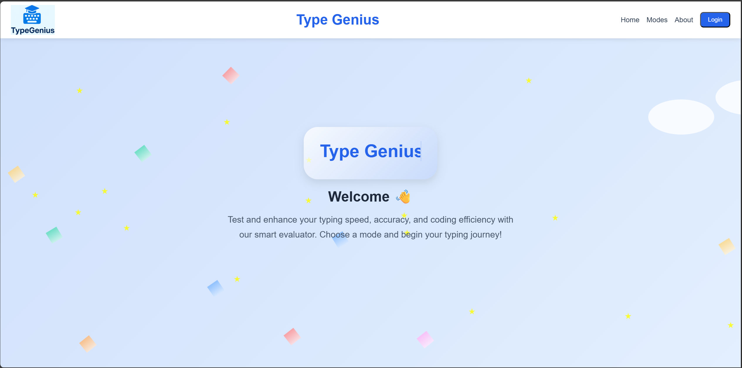
WORK DONE

Slide 18
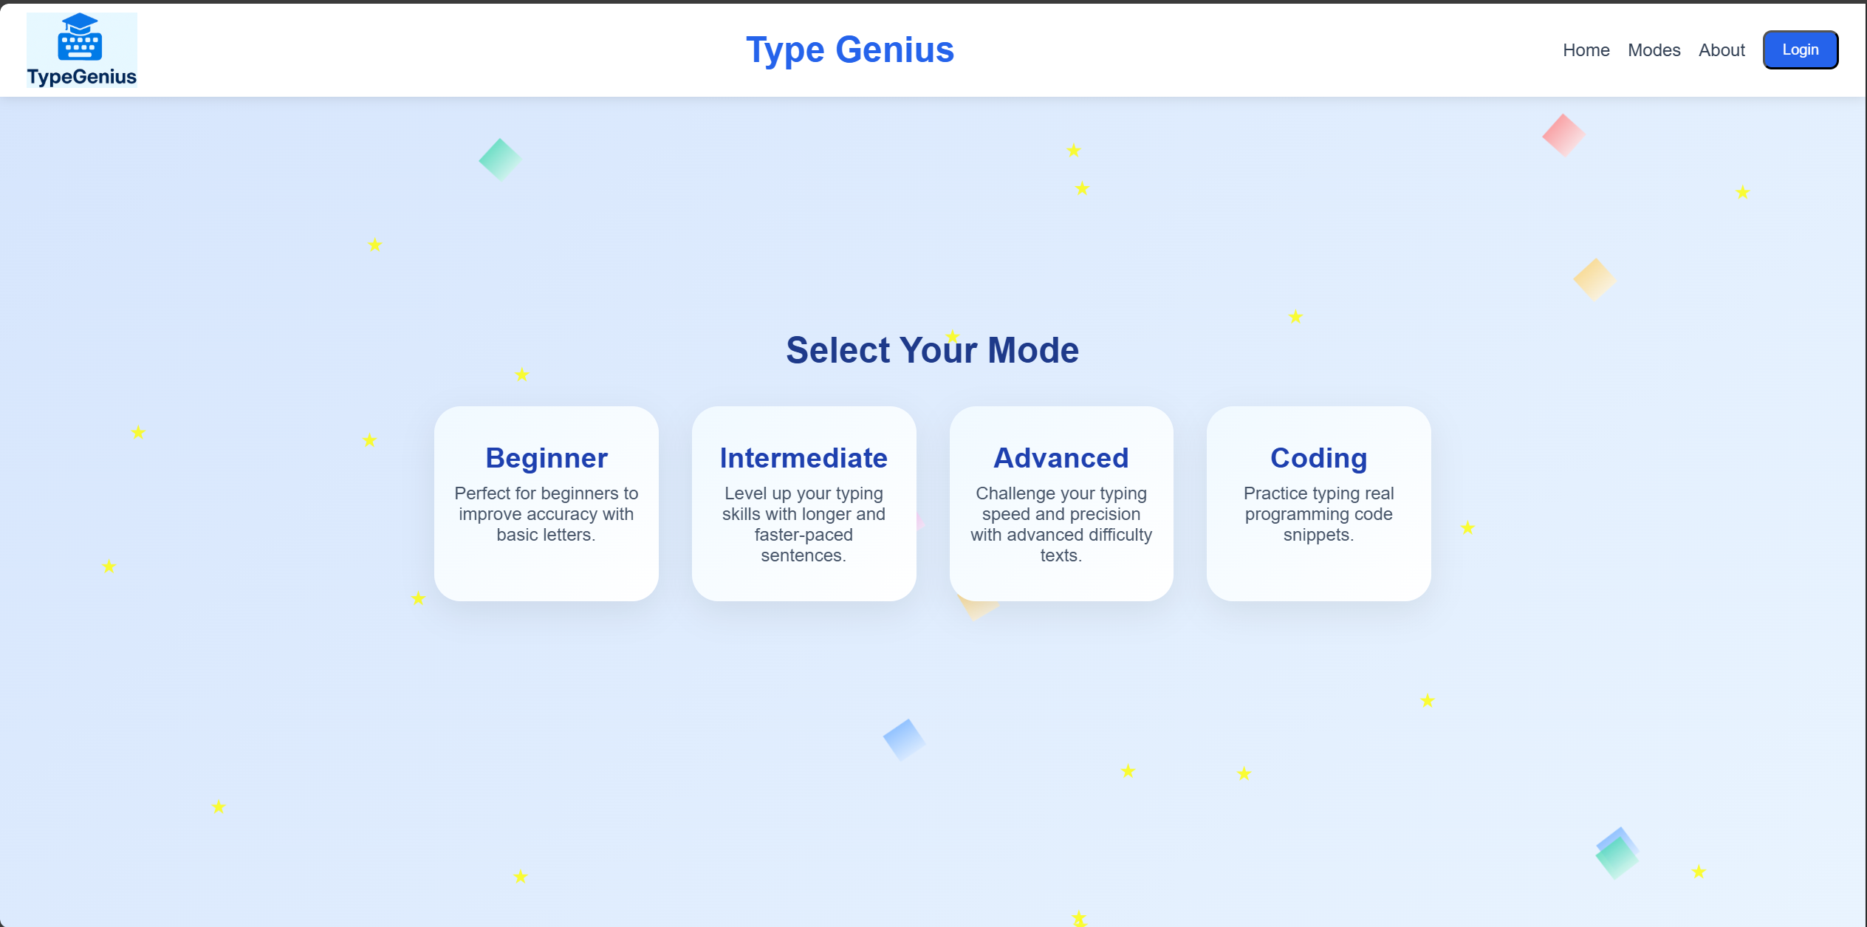

Slide 19
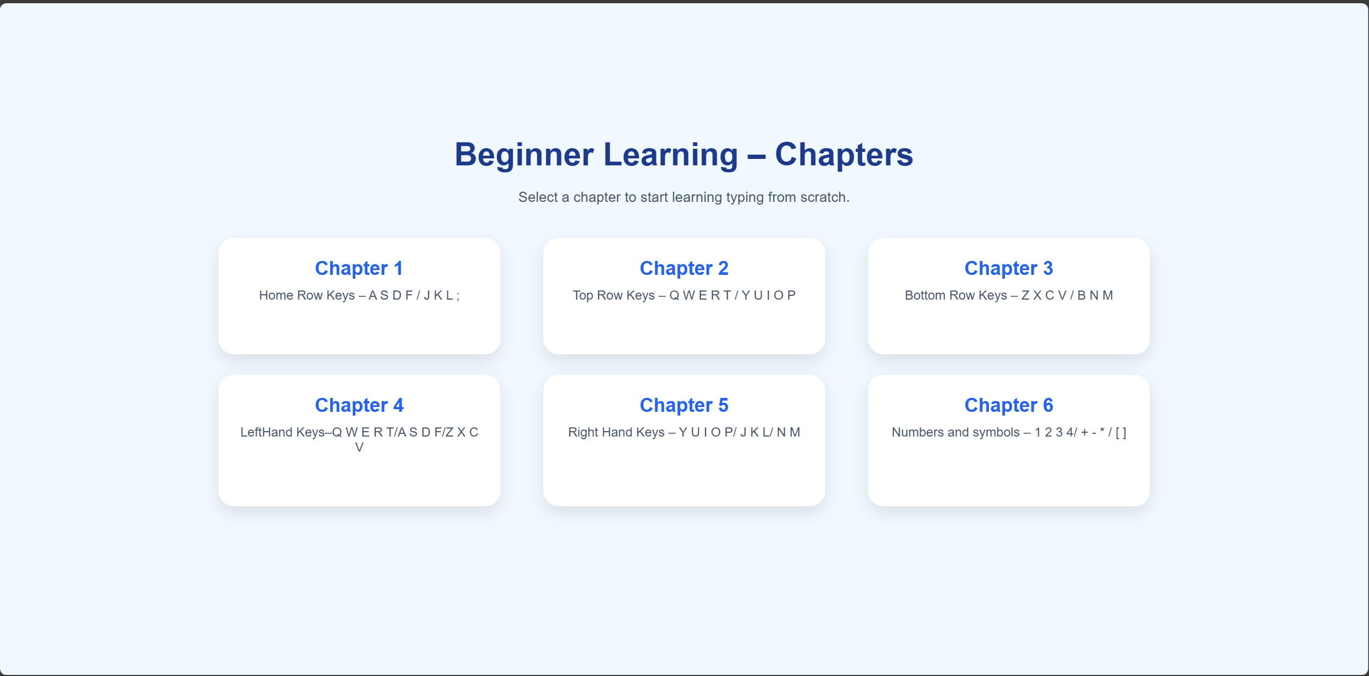

Slide 20
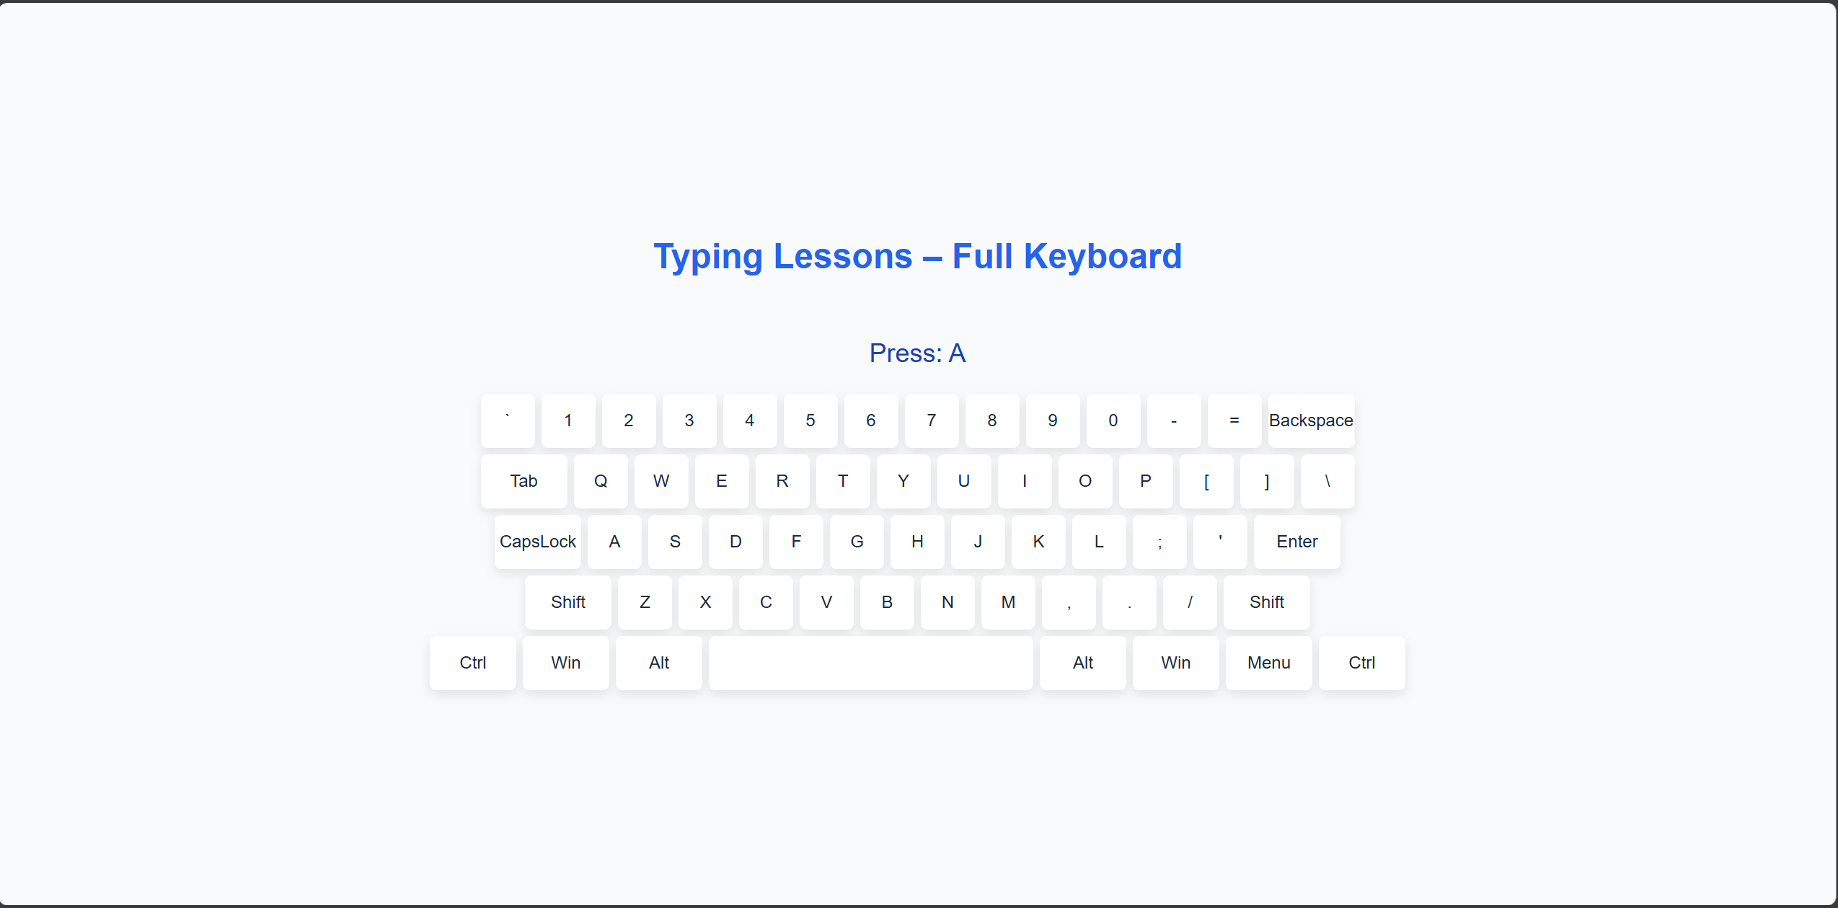

Slide 21
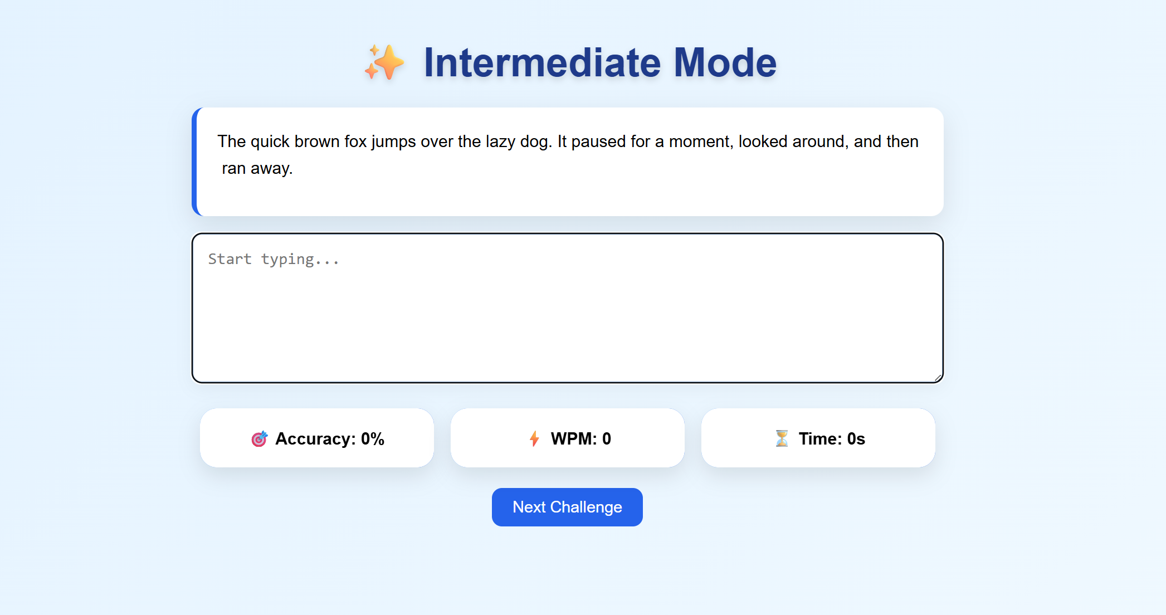

Slide 22
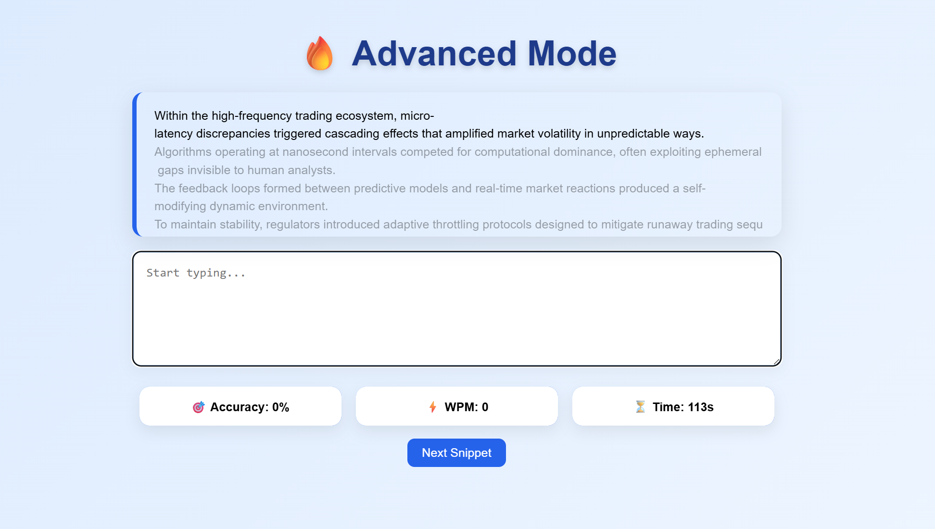

Slide 23
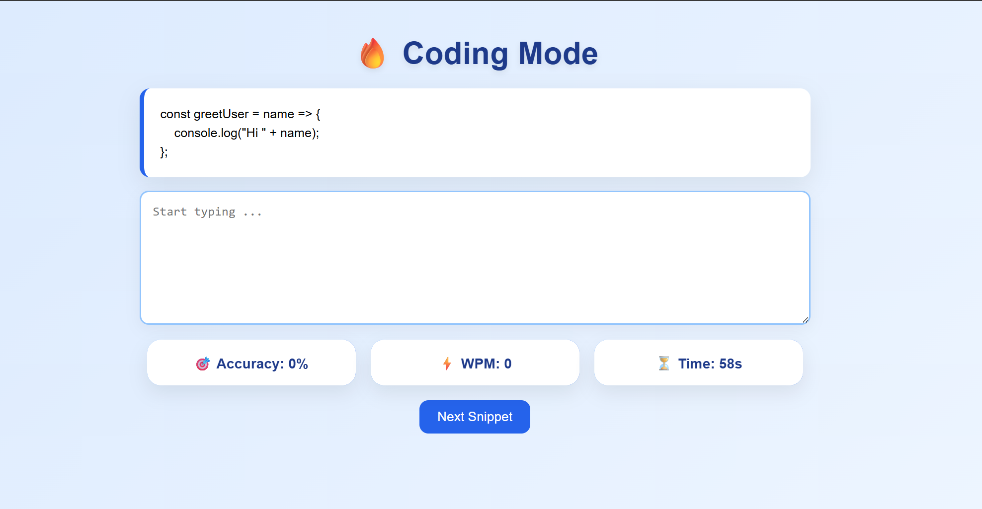

Slide 24
THANK YOU

